Slide 1
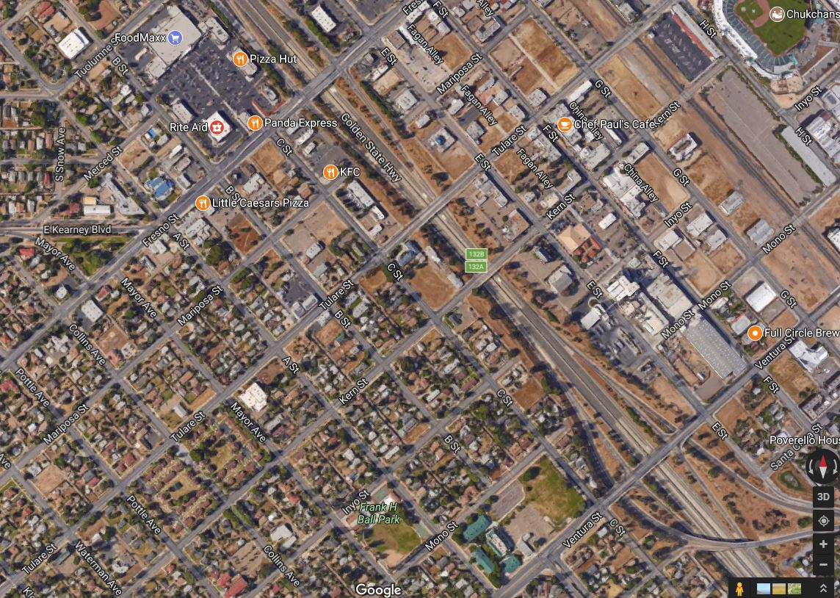
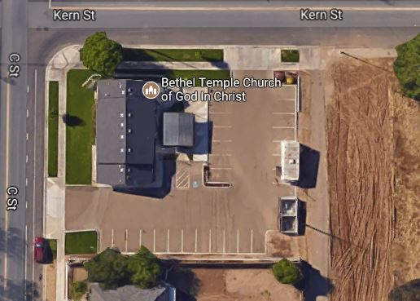
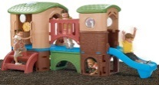
Overview
Urban Greening of
Shaded Toddler Playground
Applicant: Early Readers Preschool
(ERP)– Bethel Temple (BT) COGIC
Implementer: Hill’s Construction,
ERP and BT.
1224 Kern St., Fresno, CA 93706
Southwest (SW) Fresno
Corner of Kern/C St.
3,600 square feet, shaded cover,
2 play areas, and a bathroom
TCC Funding Ask $50,350
Matching Funding $25,000
Total Budget $164,810
Project is Scalable
Map Showing Location
Photograph of Site

Slide 2
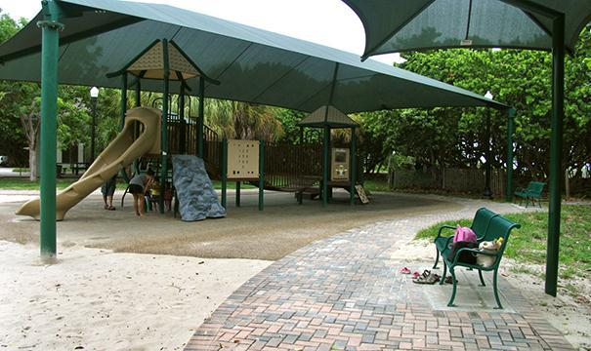
Benefits and Impacts
1st Element: Shaded open space with planting
2nd Element: Additional toddler park as SW is very limited.
3rd Element: Made public by reservations in a gated area.
4th Element: The land is located in SW; the project is operated and owned by SW residents and business owners.
5th Element: Walking distance to HSR, Chinatown, the stadium, and biking distance to SCCCD.

Slide 3
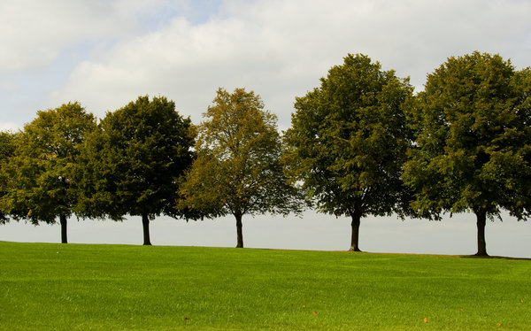
TCC Goals and Criteria
Fulfills TCC Goal of reducing
GHG by planting trees and
green landscaping around the
playground.
Fulfills TCC Criteria of
urban greening.
Fulfills TCC Goal of Public
Health and Environment
by increasing green open
park space.
Fulfills TCC Criteria of urban
greening.

Slide 4
Readiness
Obtained property/site control – Jim and Carla Hill
Matching funds already received recently for ERP’s location.
Identified vendors.
Blue Prints submission.
Our project would be completed within 6 months after permits and funding
Image Illustrating
Readiness

Slide 5
Close
Project’s potential for broader Impact to promote healthy exercising for children under 5. We expect an increase in use of parks in SW Fresno as it’s gated and monitored.
1st Element: Shaded open space with planting and toddler parks in SW are very limited.
2nd Element: The land is located in SW; the project is operated and owned by SW residents and business owners.
3rd Element: Walking distance to HSR, Chinatown, the stadium, and biking distance to SCCCD.

